Slide 1


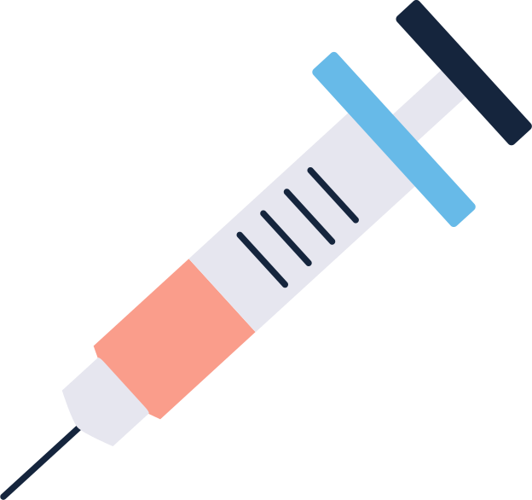





Your Healthcare Presentation
AI diagnostic of your health problems

Slide 2








Stages
01
02
03
Finding the Dataset
Choosing two models for fine-tuning
Training & Comparison

Slide 3

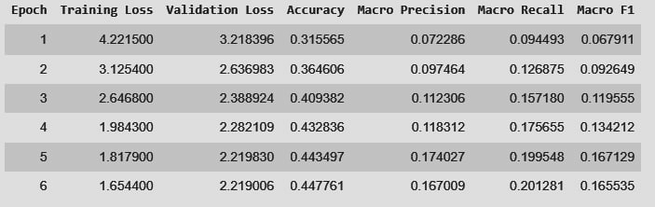
ai-forever’s ruBERT-large

Slide 4
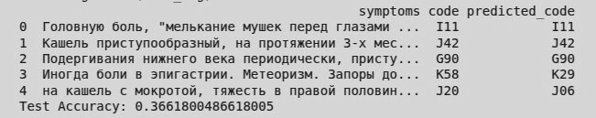
DeepPavlop’s ruBERT-base-cased

Slide 5
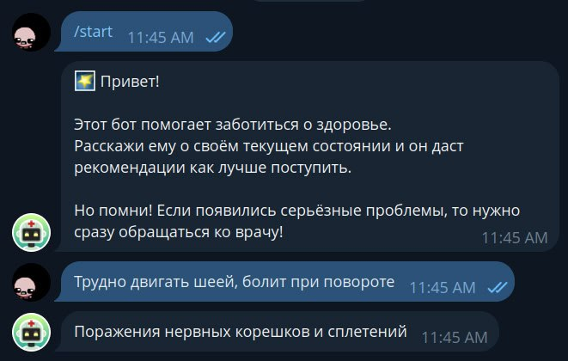
Integration into telegram bot

Slide 6
Your Healthcare Presentation
Thanks for attention

